Slide 1
Microsoft C Sharp
Basic Programming Constructs

Slide 2
Topics
Data Types
Identifier
Keywords
Variables
Constants
Type Casting
Type Conversion
Arithmetic Expressions

Slide 3
Data Types
Type | Represents | Range | Default Value
bool | Boolean value | True or False | FALSE
byte | 8-bit unsigned integer | 0 to 255 | 0
char | 16-bit Unicode character | U +0000 to U +ffff | '\0'
decimal | 128-bit precise decimal values with 28-29 significant digits | (-7.9 x 10²⁸ to 7.9 x 10²⁸) / 10^{0 to 28} | 0.0M
double | 64-bit double-precision floating point type | (+/-)5.0 x 10⁻³²⁴ to (+/-)1.7 x 10³⁰⁸ | 0.0D
float | 32-bit single-precision floating point type | ERROR -3.4 x 10³⁸ to + 3.4 x 10³⁸ | 0.0F
int | 32-bit signed integer type | -2,147,483,648 to 2,147,483,647 | 0
long | 64-bit signed integer type | -923,372,036,854,775,808 to 9,223,372,036,854,775,807 | 0L
sbyte | 8-bit signed integer type | -128 to 127 | 0
short | 16-bit signed integer type | -32,768 to 32,767 | 0
uint | 32-bit signed integer type | 0 to 4,294,967,295 | 0
ulong | 64-bit signed integer type | 0 to 18,446,744,073,709,551,615 | 0
ushort | 16-bit signed integer type | 0 to 65,535 | 0

Slide 4
Keywords
Reserved Keywords
abstract | as | base | bool | break | byte | case
catch | char | checked | class | const | continue | decimal
default | delegate | do | double | else | enum | event
explicit | extern | FALSE | finally | fixed | float | for
foreach | goto | if | implicit | in | in (generic modifier) | int
interface | internal | is | lock | long | namespace | new
null | object | operator | out | out (generic modifier) | override | params
private | protected | public | readonly | ref | return | sbyte
sealed | short | sizeof | stackalloc | static | string | struct
switch | this | throw | TRUE | try | typeof | uint
ulong | unchecked | unsafe | ushort | using | virtual | void
volatile | while

Slide 5
Identifier (Variable names)
An identifier is a name used to identify a class, variable, function, or any other user-defined item. The basic rules for naming classes in C# are as follows:
A name must begin with a letter that could be followed by a sequence of letters, digits (0 - 9) or underscore. The first character in an identifier cannot be a digit.
It must not contain any embedded space or symbol like ? - +! @ # % ^ & * ( ) [ ] { } . ; : " ' / and \. However an underscore ( _ ) can be used.
It should not be a C# keyword.

Slide 6
Variables
<data_type> <variable_list>;
int a , b ;
float x , y;
Initialization
int a = 5 , b = 6;
char c = ‘y’ ;
double pi = 3.14;
User Input
1. int num;
2. num = Convert.ToInt32(Console.ReadLIne());

Slide 7
Initialization value
Integer Literals | Examples
Integer can be in decimal, octal, or hexadecimal Prefix 0x for hexadecimal 0 for octal Nothing for decimal Suffix U for unsigned L for long | 85 /* decimal */ 0213 /* octal */ 0x4b /* hexadecimal */ 30 /* int */ 30u /* unsigned int */ 30l /* long */ 30ul /* unsigned long */

Slide 8
Initialization value
Floating Point Literals
integer part, a decimal point, a fractional part, and an exponent part.
decimal form or exponential form.
Decimal Form → 3.14159
Exponential Form → 314159E-5L

Slide 9
Initialization value
String Literals
enclosed in double quotes "" or with @"".
plain characters, escape sequences, and universal characters.
break a long line into multiple lines using string literals and separating the parts using whitespaces.
1. "hello, dear"
2. "hello, \
dear"
3. "hello, " "d" "ear"
4. @"hello dear"

Slide 10
Initialization value
Escape sequence | Meaning
\\ | \ character
\' | ' character
\" | " character
\? | ? character
\b | Backspace
\n | Newline
\r | Carriage return
\t | Horizontal tab
\v | Vertical tab

Slide 11
Constants
Constants are defined using the const keyword.
Value cannot be changed once assigned.
Syntax
const <data_type> <constant_name> = value;
Example
const double pi = 3.14159;

Slide 12
Type Casting
Implicit Type conversion
Safe conversion without data lose
Smaller to larger data types
Explicit Type conversion
Conversion on demand
Data may be lost

Slide 13
Type Conversion
Convert.ToInt32(x) | Methods & Description
ToBoolean | Converts a type to a Boolean value, where possible.
ToByte | Converts a type to a byte.
ToChar | Converts a type to a single Unicode character, where possible.
ToDateTime | Converts a type (integer or string type) to date-time structures.
ToDecimal | Converts a floating point or integer type to a decimal type.
ToDouble | Converts a type to a double type.
ToInt16 | Converts a type to a 16-bit integer.
ToInt32 | Converts a type to a 32-bit integer.
ToInt64 | Converts a type to a 64-bit integer.
ToSbyte | Converts a type to a signed byte type.
ToSingle | Converts a type to a small floating point number.
ToString | Converts a type to a string.
ToType | Converts a type to a specified type.
ToUInt16 | Converts a type to an unsigned int type.
ToUInt32 | Converts a type to an unsigned long type.
ToUInt64 | Converts a type to an unsigned big integer.

Slide 14
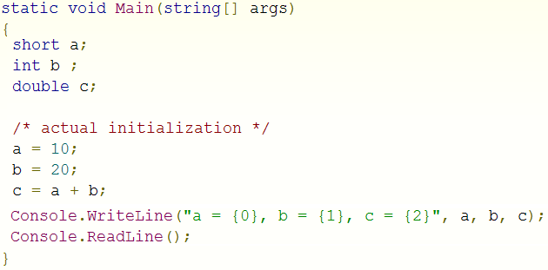
Example Program 1

Slide 15
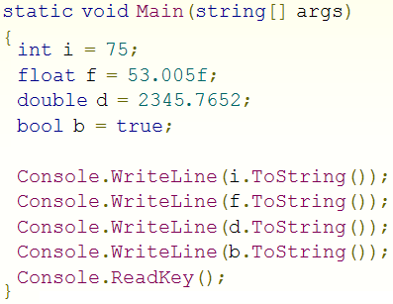
Example Program 2

Slide 16
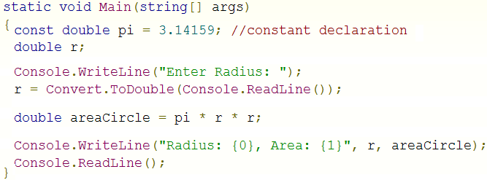
Example Program 3

Slide 17
Arithmetic Expression
Arithmetic Operators
^ power ?
* , / , % multiply,divide,modulus
+ , - add , subtract
++ increment
-- decrement

Slide 18
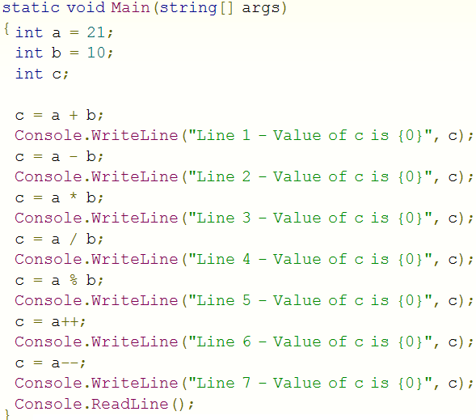
Example Program 4
31
11
210
2
1
21
22

Slide 19
Arithmetic Expression
Binary Operators Precedence
() brackets – to change precedence
^
* , / , %
+ , -

Slide 20
Examples
Y = a + b + c + d
Y = a + b - c + d
Y = a + b * c + d
Y = a + b * c / d
Y = a * b / c ^ d
Y = a * (b + c) - d

